Slide 1
Software Is Eating the World, But AI Is Going To Eat Software!
Programing → Learning

Slide 2
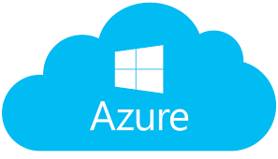



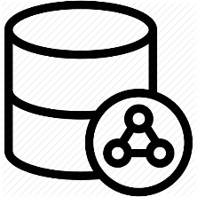




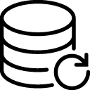
Training/validating phase
Alert
Convolution neural net
Training data
Input data
Save model
Application interface
Request/Respose
Request/Respose
Trained model
API gate way
Inference phase
Save data
ETL
ETL
Validate data
OLAP database
OLTP database

Slide 3
Training data

